Slide 1
Beginner Zeek Training
Session #1
Taylor Schutt
Cybersecurity Administrator CENIC Information Security Office
Notes:
Introductions
Provide a brief overview explaining that this presentation was created as a training resource for individuals that have never used Zeek before and that this training resource has been implemented within CENIC’s ISO Internship Program.

Slide 2
What is Zeek?
Zeek is a passive, open-source network traffic analyzer. This tool is often used as a Network Security Monitoring (NSM) solution to support investigations of suspicious or malicious activity.
This solution is able to be run on commodity hardware and provides organizations with a lower cost alternative to proprietary solutions.
Zeek is deployed across a large variety of sites including universities, research labs, supercomputing centers, major corporations, and government agencies.

Slide 3
Who Uses Zeek?
● Malware Researchers
● Network Defenders ○ .edu / .gov / private sector ○ Forensics, Monitoring, Detection
● Network Researchers ● People building Zeek in their products

Slide 4



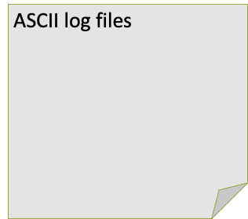

Zeek Architecture
Zeek NSM
Sniffs traffic
Generates logs
http.log
ssl.log
ssh.log
smtp.log
weird.log
notice.log
Notes:
Zeek functions by ingesting network traffic and generates various log files from the raw network traffic.
These log files may contain information pertaining to network traffic that corresponds with standard networking protocols. (i.e. http, https, ssh, ftp, etc.).
These log files may also contain traffic that reports on abnormal network activity. (i.e. http traffic detected on a non-standard port like 20 or 21.)
Zeek provides developers with the capability to create their own scripts to extend and customize Zeek’s functionality.
These scripts may also be utilized to create custom log files that are created whenever activity traverses across the network that meets particular parameters or conditions.

Slide 5
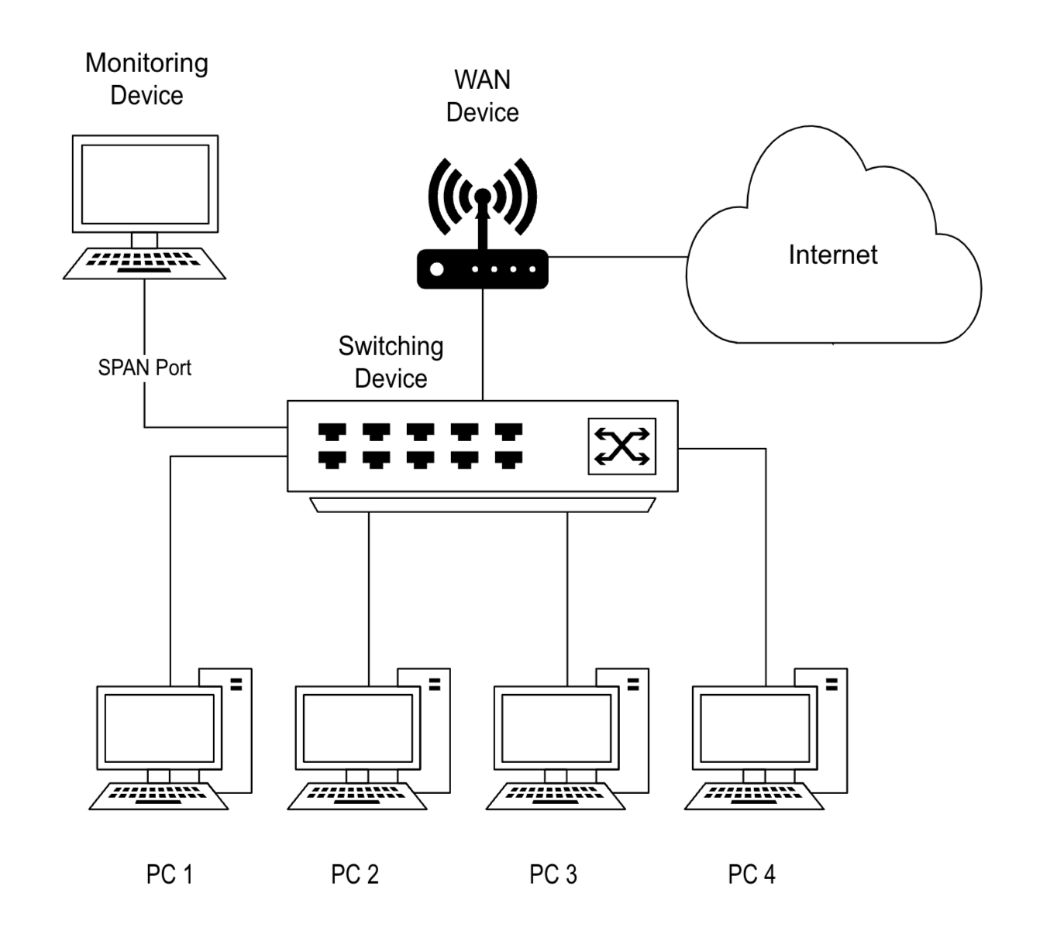
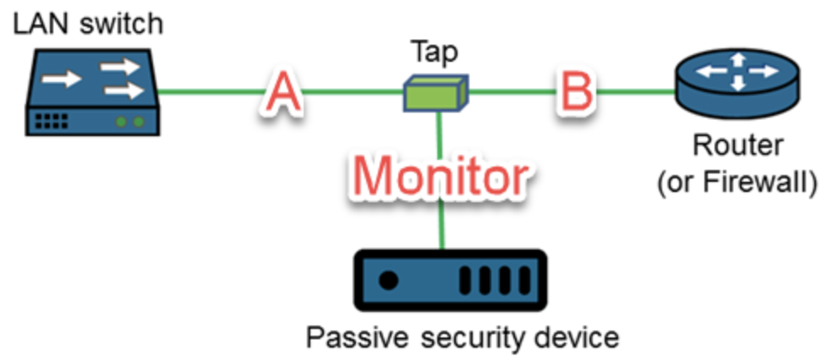
Zeek Architecture
SPAN
vs
TAP
Notes:
Zeek is typically configured for network monitoring via a SPAN or a TAP.
SPAN (Switched Port Analyzer) - this refers to a port mirroring feature on a network appliance that sends copies of network traffic to network monitoring tools.
TAP (Test Access Point) - this refers to a hardware device that sits between two appliances like a router, switch, or a firewall. TAPs provide a complete view of network traffic including errors or anomalies.
TAP is the preferred method of getting traffic to Zeek in a production environment due to the shortcomings of port mirrored feeds such as: potential packet loss, switch resource consumption, and the potential for limited visibility if there is abnormally high network traffic or if a switch malfunctions.

Slide 6
Container Overview
We will be utilizing a container to run Zeek within the Docker Desktop Application.
A container refers to a package of software that contains all of the necessary elements to run an application in any operating system environment.
Containers are lightweight, scaleable, and allow applications to move between different environments such as Windows, Apple, and Linux devices.
The container image will allow us to practice using this software in an isolated environment that is independent of our host operating system.

Slide 7
Docker / Zeek Usage
Step 1: Setup Docker on your system, open the application, and open a terminal session.
https://docs.docker.com/engine/install/ubuntu/
https://docs.docker.com/desktop/install/mac-install/
https://docs.docker.com/desktop/install/windows-install/
Step 2: Setup your Zeek Docker image
Grab the latest Zeek LTS image:
docker pull zeek/zeek:lts
docker run -it zeek/zeek:lts /bin/bash
Inside the container, set up the resources that will be used during this training:
git clone https://github.com/zeek/zeek-training
cd /zeek-training
./setup.sh all
Note: You will only need to run these commands once in order to create the container & download the training resources.
Notes:
The “docker pull” command will download the container’s image to your system from the developer’s repository.
The “docker run -it” command will create and run a container from the image within an interactive terminal session.

Slide 8
Docker Setup
Step 3: Verify that Zeek has been installed correctly:
zeek –-version
Step 4: Enter the following commands to create a new folder within the logs directory, navigate into the new directory, and verify your present working directory:
mkdir -p /zeek/logs/capture_pcap && cd /zeek/logs/capture_pcap && pwd
Step 5: Verify that you are in: /zeek/logs/capture_pcap from the previous step.
Step 6: Enter the following commands to analyze a sample pcap file:
zeek -C -r /zeek-training/Intro-to-Zeek/training-res/traces/capture.pcap
ls
Notes:
When you are analyzing a packet capture in Zeek, the first thing you will need to do is enter the “zeek” command, followed by the options that you would like to use to process the output.
In this example, we are using the Zeek command to read a pcap file and generate the corresponding log files that we will be analyzing in the following exercises.
The “zeek” command prompts the zeek application to perform a certain action.
All of the actions & options that can be utilized with the “zeek” command may be viewed by entering “zeek --help” in the command line.
When we run the zeek command, the “-C” option ignores checksums or any errors that may be generated when the pcap file is being analyzed.
The -r option specifies that this information should be read from the following path to the specified file.

Slide 9
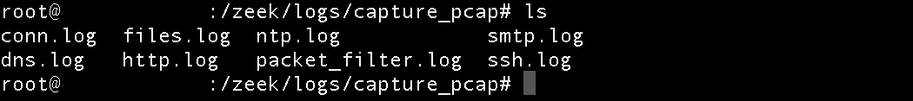
Logs
● Zeek generates log files based on the protocols that it sees in your
network traffic. (More than 50 protocols are currently parsed)
● Apart from conventional protocol log files, Zeek also makes a record of interesting logs pertaining to noticeable or abnormal activity. (weird.log, notice.log, etc.)
Log File Overview: https://docs.zeek.org/en/master/logs/index.html

Slide 10
Zeek Cut
Each log file consists of a set of headers or fields that contain information such as: timestamp, unique identifier, source IP address, destination IP address, protocol, duration, and more.
Zeek-cut is a command that allows you to extract individual columns from log files.
This makes it easier for analysts to interact with Zeek logs by specifying the headers of the information that they would like to parse from the complete log file.

Slide 11
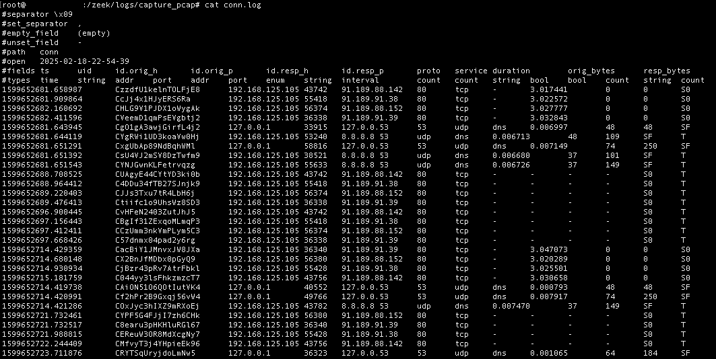
Standard Log Output
Notes:
This slide is a representation of the normal output that is presented on the screen when we utilize the concatenate command to view the entire log file.
As you can see, there are several different elements and columns that populate the screen which would make it difficult for an analyst to view or parse through this log file efficiently.

Slide 12
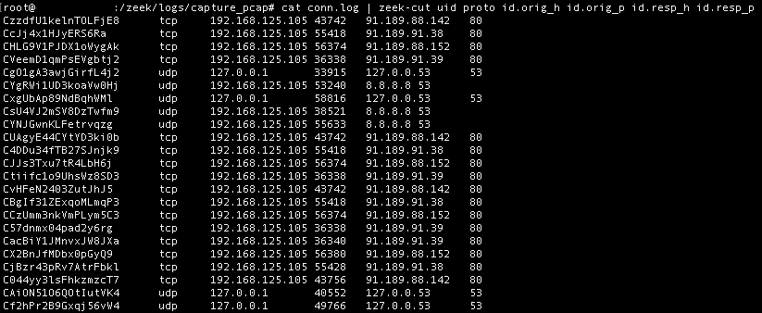
Zeek-Cut Output
Notes:
In comparison, this slide represents the output that is displayed on the screen when we utilize the zeek-cut command.
This command allows us to specify which columns that we would like to select from the log file and presents the information in a format that is much easier to sort through and analyze accordingly.

Slide 13
Log Processing Commands
There are various commands that may be used in conjunction with zeek cut to sort, filter, and modify the output of your queries.
In order to use these commands in conjunction with zeek-cut, we will be utilizing the pipe “ | ” operator.
The pipe operator will ingest the output of the preceding command and allow us to perform additional filtering operations to the data in order to receive our desired output.

Slide 14
Log Processing Commands
sort - This tool allows you to sort lines within text files.
cat conn.log | zeek-cut id.orig_h resp_bytes | sort -rnk2 | head
192.168.125.105 60505 192.168.125.1 60502 192.168.125.1 60496 192.168.125.1 60484 192.168.125.1 60484 192.168.125.1 49782 192.168.125.1 49779 192.168.125.1 49776 192.168.125.1 49773 192.168.125.1 49773
Notes:
On this slide, we utilized the zeek-cut command in order to extract the source IP address column and the respondent bytes column. We also utilized the sort command with the following options: -rnk2
The -r option sorts the output in reverse order. (from largest to smallest)
The -n option sort the output in numerical order.
The -k option specifies the “key” that determines which column the information should be sorted by.
The number 2 that follows the k specifies that column 2 (resp_bytes) will be the column that is referenced when this data is sorted and presented within the final output.
The head command allows us to specify that the output should only contain the first ten entries by default. The head command may also be modified with the -n option followed by another number to indicate if we would like to have a different number of results displayed in the output.
Example 1: “head -n 3” would display the first 3 entries that were observed in the log file with the given parameters.
Example 2: “head -n 20” would display the first 20 entries that were observed in the log file with the given parameters.

Slide 15
Log Processing Commands
uniq - This tool allows you to filter out repeated lines in a file.
cat conn.log | zeek-cut id.orig_h id.resp_p | sort | uniq -c | sort -rnk1 129 192.168.125.1 80 25 127.0.0.1 53 24 192.168.125.105 80 17 ::1 80 13 192.168.125.105 123 8 192.168.125.105 53 7 192.168.125.105 5000 4 192.168.125.105 0 2 fe80::f816:3eff:fed7:36aa 134 2 192.168.125.1 25 1 192.168.125.106 22
Notes:
On this slide, we utilized the zeek-cut command in order to extract the source IP address column and the destination port column.
We also utilized the sort and uniq commands to display the total unique instances where a source IP address was communicating with a destination port in the log file.
The sort command is used in order to sort the contents of the file in a logical order and must be specified before passing the output to the uniq command or else the output will display inaccurate results.
The uniq command with the -c option is used to prefix lines by the total number of occurrences within the file.
The sort command is used once more to sort the output in reverse numerical order and specifies the source IP address column as the “key” that the information should be sorted by.

Slide 16
Log Processing Commands
awk - This tool is a pattern-directed scanning and processing language which may be used to specify parameters that must be fulfilled within the output of the query.
Find hosts with http not on port 80 awk '$8 == "http" && $6 != 80 { print $0 }' conn.log
Total resp_bytes for host : awk '$3 == "192.168.125.105" {sum += $11} END {print sum}' conn.log
Notes:
The awk command may be utilized to specify certain conditions that must be met in order to be displayed within the output of the query.
First example:
$8 == “http” identifies all instances where the field in column 8 is equal to “http”.
&& $6 != 80 the “&&” operator includes an additional condition that must be met in order for the condition to be met.
The second condition which must be met is column 6 not containing “80” within the corresponding field.
{ print $0 } will print all of the corresponding fields within the log file if both of these conditions are met.
Second example:
$3 == “192.168.125.105” identifies all instances where the IP address 192.168.125.105 is observed as a field within the third column.
{sum += $11} will perform the following action of adding up the sum of any fields in column 11 whenever the previous condition is fulfilled.
The END rule specifies that any following actions should only be performed after all of the input is read and processed.
{print sum} will print out the result of the resp_bytes that were identified which fulfilled the parameters that were outlined within the query.

Slide 17
Log Processing Exercises
Directory: /zeek/logs/capture_pcap
File: /zeek/logs/capture_pcap/conn.log
Using the sort command, show the connections from the shortest to the longest duration. (Hint: Refer to the speaker notes on slide 17) Query:
Using the sort & uniq commands, show the top 5 destination ports from largest to smallest. (Hint: Refer to the speaker notes on slides 17 and 18) Query:
Using awk, find all connections that have a duration longer than 5 seconds. (Hint: Refer to the speaker notes on slide 19) Query:

Slide 18
Q & A
Questions?
Discussion
Key Takeaways

Slide 19
Additional Resources
Website: https://zeek.org
Slack: https://zeek.org/slack
Discourse: https://community.zeek.org
Find out more ways to connect at: https://zeek.org/community/
Zeek Training Resources: https://github.com/zeek/zeek-training/tree/master/Intro-to-Zeek/training-res
Log File Overview: https://docs.zeek.org/en/master/logs/index.html

Slide 20
Citation
The theme for these slides and portions of the content within this presentation were borrowed from existing Zeek training material.
Authors: Keith Lehigh, Christian Kreibich, Fatema Bannat Wala
Reference: Introduction to real-world Zeek deployment

